Slide 2

What is so special about this Google Doodle?

Slide 3

This was Google’s first ever doodle.
Fun Fact: It was actually an out-of-office message to inform the users that Google employees were out of office as they were attending the Burning Man Festival in Nevada

Slide 4
“I’m 01100110 01100101 01100101 01101100 01101001 01101110 01100111 00100000 01101100 01110101 01100011 01101011 01111001 00001010”
Google posted the above as their first post at which popular social networking and blogging site? (Follow up ques : what do these binary digits denote? – feeling lucky)

Slide 5


Slide 6
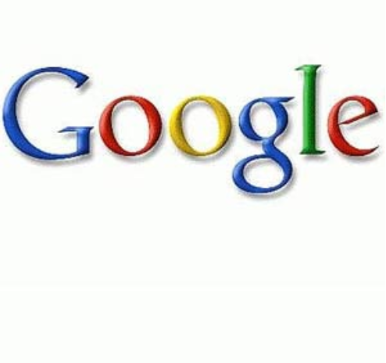
What was Google meant to be originally named as?

Slide 7
“Googol”, meaning 1 followed by 10 to the power 100 zeroes. It represents the massive amount of information present on the internet

Slide 8
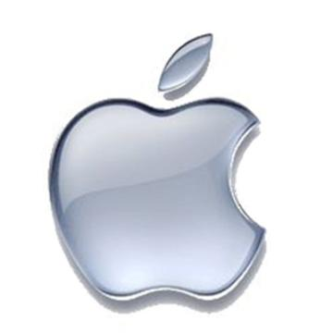
Apple’s first logo featured a famous English physicist, mathematician, astronomer, natural philosopher, alchemist and theologian. Who was he?

Slide 9

Sir Isaac Newton

Slide 10
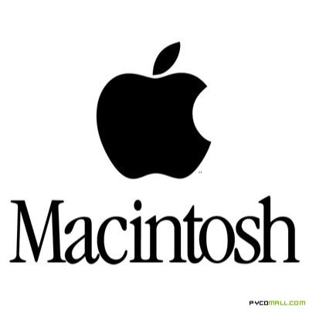
Where did the name ‘Macintosh’ come from?

Slide 11
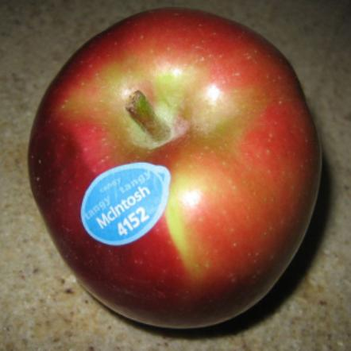
An Apple

Slide 12
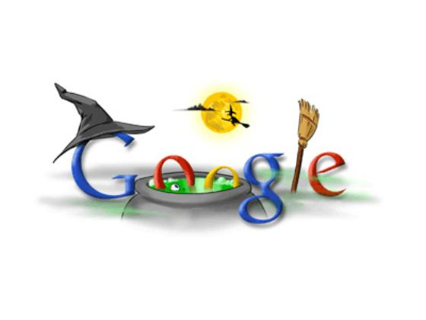
What is Google’s famous motto?

Slide 13

“Don’t be evil”
It refers to their corporate philosophy that says that you can make money without being evil.

Slide 14
FUN FACTS
  You cannot create a folder named ‘con’ in Windows
  Microsoft employees are called “softies”

